Slide 1

Chapter 5
Discrete Probability Distributions

Slide 2
Objectives
In this chapter, you learn:
The properties of a probability distribution.
To compute the expected value and variance of a probability distribution.
To compute probabilities from binomial, and Poisson distributions.
To use the binomial, and Poisson distributions to solve business problems

Slide 3
Definitions
Discrete variables produce outcomes that come from a counting process (e.g. number of classes you are taking).
Continuous variables produce outcomes that come from a measurement (e.g. your annual salary, or your weight).

Slide 4
Types Of Variables
Types Of
Variables
Ch. 5
Ch. 5
Ch. 5
Ch. 6
Ch. 6
Discrete
Variable
Continuous
Variable
Ch. 6

Slide 5

Discrete Variables
Can only assume a countable number of values
  Examples:
  Roll a die twice
Let X be the number of times 4 occurs
(then X could be 0, 1, or 2 times)
  Toss a coin 5 times.
  Let X be the number of heads
  (then X = 0, 1, 2, 3, 4, or 5)

Slide 6
Probability Distribution For A Discrete Variable
A probability distribution for a discrete variable is a mutually exclusive listing of all possible numerical outcomes for that variable and a probability of occurrence associated with each outcome.
Interruptions Per Day In Computer Network | Probability
0 | 0.35
1 | 0.25
2 | 0.20
3 | 0.10
4 | 0.05
5 | 0.05

Slide 7
Probability Distributions Are Often Represented Graphically
P(X)
0.4
0.3
0.2
0.1
0 1 2 3 4 5 X

Slide 8
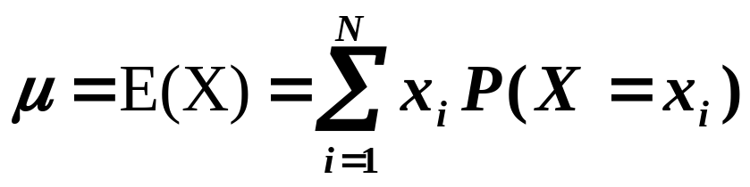
Discrete Variables Expected Value (Measuring Center)
Expected Value (or mean) of a discrete
variable (Weighted Average)
Interruptions Per Day In Computer Network (x_{i}) | Probability P(X = x_{i}) | x_{i}P(X = x_{i})
0 | 0.35 | (0)(0.35) = 0.00
1 | 0.25 | (1)(0.25) = 0.25
2 | 0.20 | (2)(0.20) = 0.40
3 | 0.10 | (3)(0.10) = 0.30
4 | 0.05 | (4)(0.05) = 0.20
5 | 0.05 | (5)(0.05) = 0.25
 | 1.00 | μ = E(X) = 1.40

Slide 9
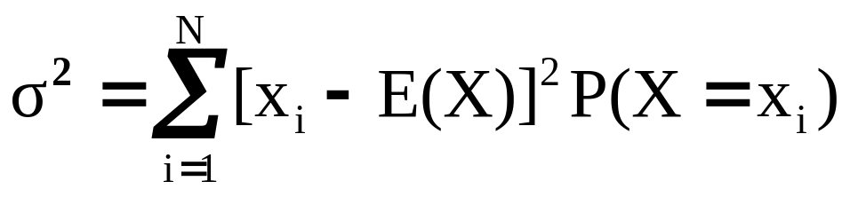
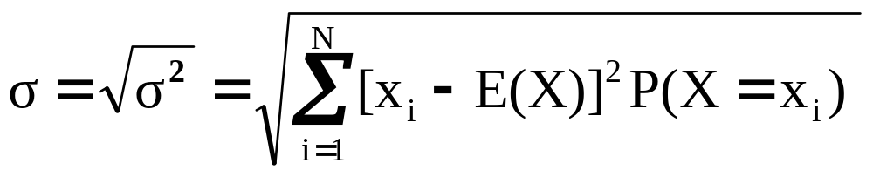
Discrete Variables:
Measuring Dispersion
Variance of a discrete variable
Standard Deviation of a discrete variable
where:
E(X) = Expected value of the discrete variable X
x_{i} = the i^{th} outcome of X
P(X=x_{i}) = Probability of the i^{th} occurrence of X

Slide 10
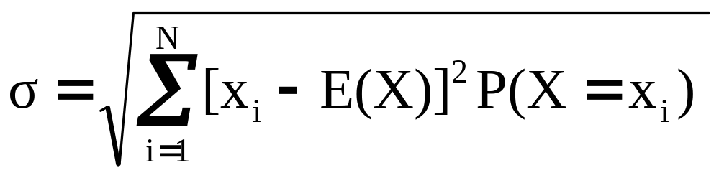
Discrete Variables:
Measuring Dispersion
(continued)
Interruptions Per Day In Computer Network (x_{i}) | Probability P(X = x_{i}) | [x_{i} – E(X)]² | [x_{i} – E(X)]²P(X = x_{i})
0 | 0.35 | (0 – 1.4)² = 1.96 | (1.96)(0.35) = 0.686
1 | 0.25 | (1 – 1.4)² = 0.16 | (0.16)(0.25) = 0.040
2 | 0.20 | (2 – 1.4)² = 0.36 | (0.36)(0.20) = 0.072
3 | 0.10 | (3 – 1.4)² = 2.56 | (2.56)(0.10) = 0.256
4 | 0.05 | (4 – 1.4)² = 6.76 | (6.76)(0.05) = 0.338
5 | 0.05 | (5 – 1.4)² = 12.96 | (12.96)(0.05) = 0.648
 |  |  | σ² = 2.04, σ = 1.4283

Slide 11
Probability Distributions
Probability Distributions
Ch. 5
Discrete
Probability Distributions
Continuous
Probability Distributions
Ch. 6
Binomial
Normal
Poisson

Slide 12
Binomial Probability Distribution
A fixed number of observations, n
  e.g., 15 tosses of a coin; ten light bulbs taken from a warehouse
Each observation is categorized as to whether or not the “event of interest” occurred
  e.g., head or tail in each toss of a coin; defective or not defective light bulb
  Since these two categories are mutually exclusive and collectively exhaustive
    When the probability of the event of interest is represented as π, then the probability of the event of interest not occurring is 1 - π
Constant probability for the event of interest occurring (π) for each observation
  Probability of getting a tail is the same each time we toss the coin

Slide 13
Binomial Probability Distribution
(continued)
Observations are independent
  The outcome of one observation does not affect the outcome of the other
  Two sampling methods deliver independence
    Infinite population without replacement
    Finite population with replacement

Slide 14
Possible Applications for the Binomial Distribution
A manufacturing plant labels items as either defective or acceptable
A firm bidding for contracts will either get a contract or not
A marketing research firm receives survey responses of “yes I will buy” or “no I will not”
New job applicants either accept the offer or reject it

Slide 15
The Binomial Distribution
Counting Techniques
Suppose the event of interest is obtaining heads on the toss of a fair coin. You are to toss the coin three times. In how many ways can you get two heads?
Possible ways: HHT, HTH, THH, so there are three ways you can getting two heads.
This situation is fairly simple. We need to be able to count the number of ways for more complicated situations.

Slide 16
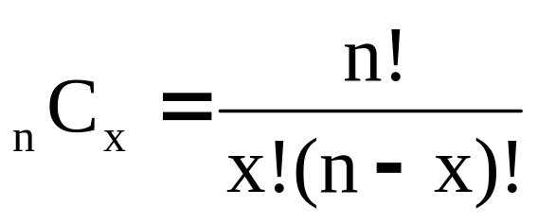
Counting Techniques
Rule of Combinations
The number of combinations of selecting x objects out of n objects is
where:
n! =(n)(n - 1)(n - 2) . . . (2)(1)
x! = (X)(X - 1)(X - 2) . . . (2)(1)
0! = 1 (by definition)

Slide 17
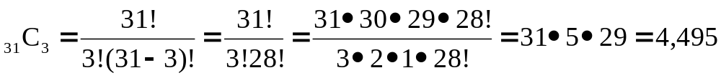
Counting Techniques
Rule of Combinations
How many possible 3 scoop combinations could you create at an ice cream parlor if you have 31 flavors to select from and no flavor can be used more than once in the 3 scoops?
The total choices is n = 31, and we select X = 3.

Slide 18
Binomial Distribution Formula
n
!
P(X=x |n,π)
=
x
n
−
x
π
(1-π)
x!
(
−
)
n
x
!
P(X=x|n,π) = probability of x events of interest in n trials, with the probability of an “event of interest” being π for each trial
x = number of “events of interest” in sample,
(x = 0, 1, 2, ..., n)
n = sample size (number of trials
or observations)
π = probability of “event of interest”
Example: Flip a coin four times, let x = # heads:
n = 4
π = 0.5
1 - π = (1 - 0.5) = 0.5
X = 0, 1, 2, 3, 4

Slide 19
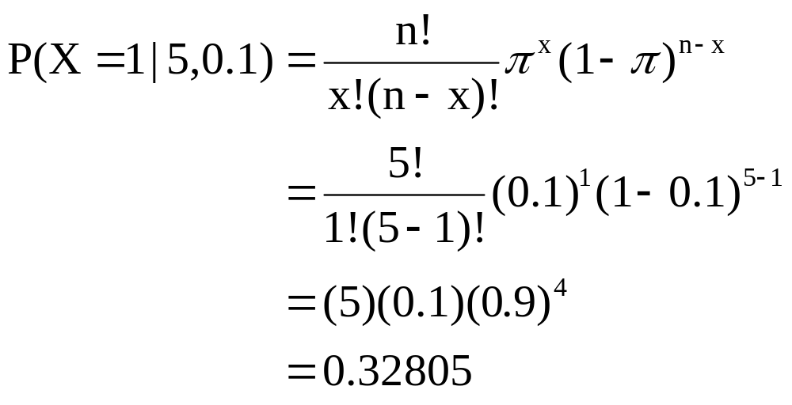
Example:
Calculating a Binomial Probability
What is the probability of one success in five observations if the probability of an event of interest is 0.1?
x = 1, n = 5, and π = 0.1

Slide 20
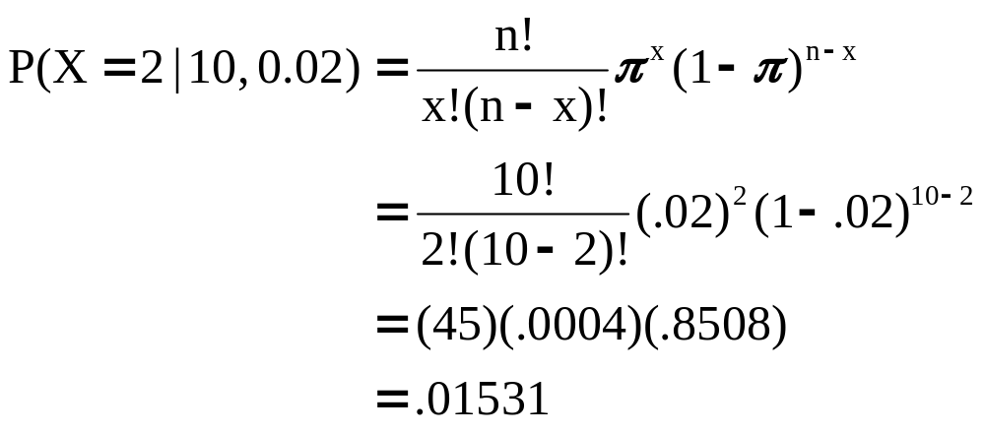
The Binomial Distribution
Example
Suppose the probability of purchasing a defective computer is 0.02. What is the probability of purchasing 2 defective computers in a group of 10?
x = 2, n = 10, and π = 0.02

Slide 21
The Binomial Distribution Shape
The shape of the binomial distribution depends on the values of π and n
P(X=x|5, 0.1)
.6
.4
.2
Here, n = 5 and π = .1
0
0
1
2
3
4
5
x
P(X=x|5, 0.5)
.6
.4
Here, n = 5 and π = .5
.2
0
0
1
2
3
4
5
x

Slide 22
The Binomial Distribution Using Binomial Tables (Available On Line)
n = 10
x | … | π=.20 | π=.25 | π=.30 | π=.35 | π=.40 | π=.45 | π=.50
0 1 2 3 4 5 6 7 8 9 10 | … … … … … … … … … … … | 0.1074 0.2684 0.3020 0.2013 0.0881 0.0264 0.0055 0.0008 0.0001 0.0000 0.0000 | 0.0563 0.1877 0.2816 0.2503 0.1460 0.0584 0.0162 0.0031 0.0004 0.0000 0.0000 | 0.0282 0.1211 0.2335 0.2668 0.2001 0.1029 0.0368 0.0090 0.0014 0.0001 0.0000 | 0.0135 0.0725 0.1757 0.2522 0.2377 0.1536 0.0689 0.0212 0.0043 0.0005 0.0000 | 0.0060 0.0403 0.1209 0.2150 0.2508 0.2007 0.1115 0.0425 0.0106 0.0016 0.0001 | 0.0025 0.0207 0.0763 0.1665 0.2384 0.2340 0.1596 0.0746 0.0229 0.0042 0.0003 | 0.0010 0.0098 0.0439 0.1172 0.2051 0.2461 0.2051 0.1172 0.0439 0.0098 0.0010 | 10 9 8 7 6 5 4 3 2 1 0
 | … | π=.80 | π=.75 | π=.70 | π=.65 | π=.60 | π=.55 | π=.50 | x
Examples:
n = 10, π = 0.35, x = 3: P(X = 3|10, 0.35) = 0.2522
n = 10, π = 0.75, x = 8: P(X = 8|10, 0.75) = 0.2816

Slide 23
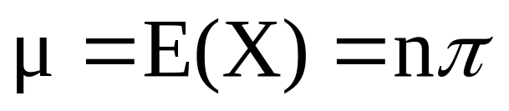
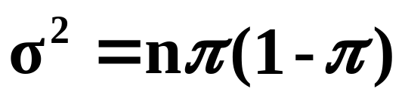
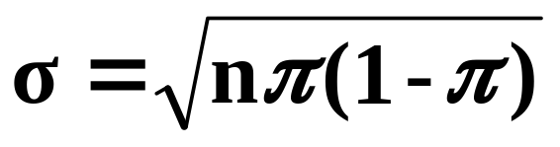
Binomial Distribution Characteristics
Mean
Variance and Standard Deviation
Where n = sample size
π = probability of the event of interest for any trial
(1 – π) = probability of no event of interest for any trial

Slide 24

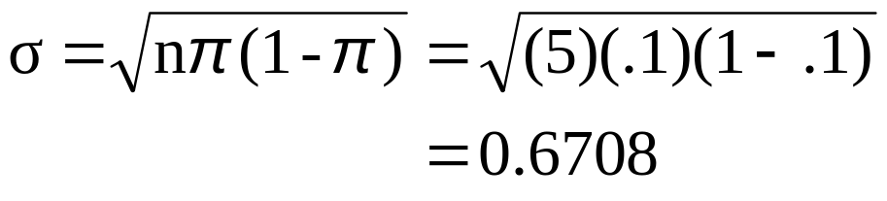

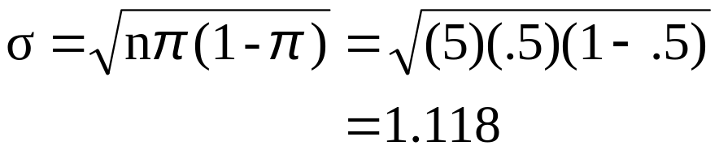
The Binomial Distribution
Characteristics
Examples
P(X=x|5, 0.1)
.6
.4
.2
0
0
1
2
3
4
5
x
P(X=x|5, 0.5)
.6
.4
.2
0
0
1
2
3
4
5
x

Slide 25
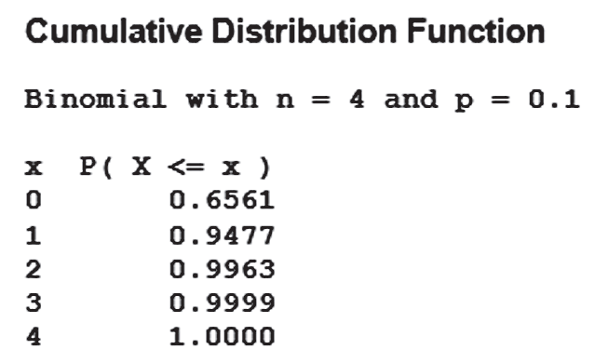
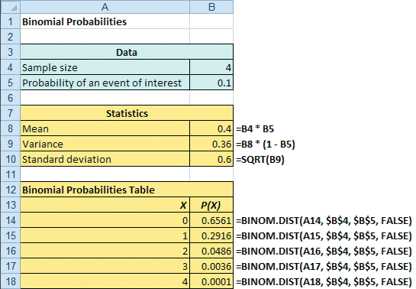
Both Excel & Minitab Can Be Used To Calculate The Binomial Distribution

Slide 26
The Poisson Distribution
Definitions
You use the Poisson distribution when you are interested in the number of times an event occurs in a given area of opportunity.
An area of opportunity is a continuous unit or interval of time, volume, or such area in which more than one occurrence of an event can occur.
  The number of scratches in a car’s paint
  The number of mosquito bites on a person
  The number of computer crashes in a day

Slide 27
The Poisson Distribution
Apply the Poisson Distribution when:
  You wish to count the number of times an event occurs in a given area of opportunity
  The probability that an event occurs in one area of opportunity is the same for all areas of opportunity
  The number of events that occur in one area of opportunity is independent of the number of events that occur in the other areas of opportunity
  The probability that two or more events occur in an area of opportunity approaches zero as the area of opportunity becomes smaller
  The average number of events per unit is λ (lambda)

Slide 28
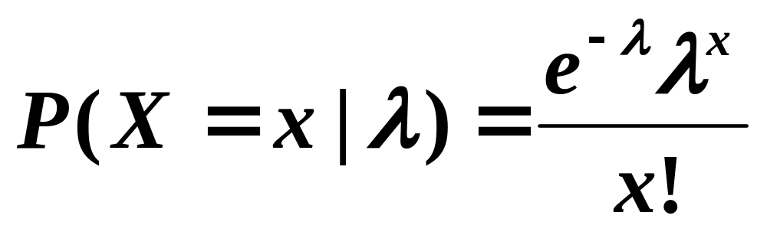
Poisson Distribution Formula
where:
x = number of events in an area of opportunity
λ = expected number of events
e = base of the natural logarithm system (2.71828...)

Slide 29
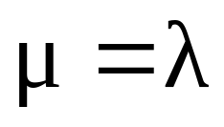
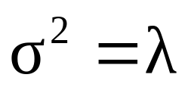
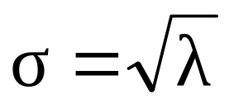
Poisson Distribution Characteristics
Mean
Variance and Standard Deviation
where λ = expected number of events

Slide 30
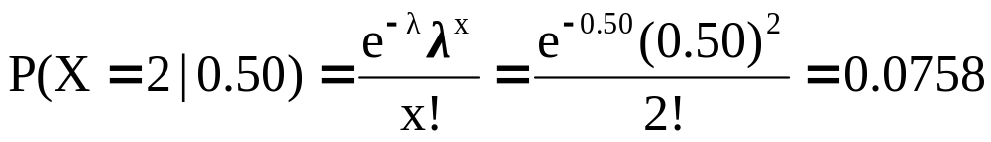
Using Poisson Tables (Available On Line)
X | λ
 | 0.10 | 0.20 | 0.30 | 0.40 | 0.50 | 0.60 | 0.70 | 0.80 | 0.90
0 1 2 3 4 5 6 7 | 0.9048 0.0905 0.0045 0.0002 0.0000 0.0000 0.0000 0.0000 | 0.8187 0.1637 0.0164 0.0011 0.0001 0.0000 0.0000 0.0000 | 0.7408 0.2222 0.0333 0.0033 0.0003 0.0000 0.0000 0.0000 | 0.6703 0.2681 0.0536 0.0072 0.0007 0.0001 0.0000 0.0000 | 0.6065 0.3033 0.0758 0.0126 0.0016 0.0002 0.0000 0.0000 | 0.5488 0.3293 0.0988 0.0198 0.0030 0.0004 0.0000 0.0000 | 0.4966 0.3476 0.1217 0.0284 0.0050 0.0007 0.0001 0.0000 | 0.4493 0.3595 0.1438 0.0383 0.0077 0.0012 0.0002 0.0000 | 0.4066 0.3659 0.1647 0.0494 0.0111 0.0020 0.0003 0.0000
Example: Find P(X = 2 | λ = 0.50)

Slide 31
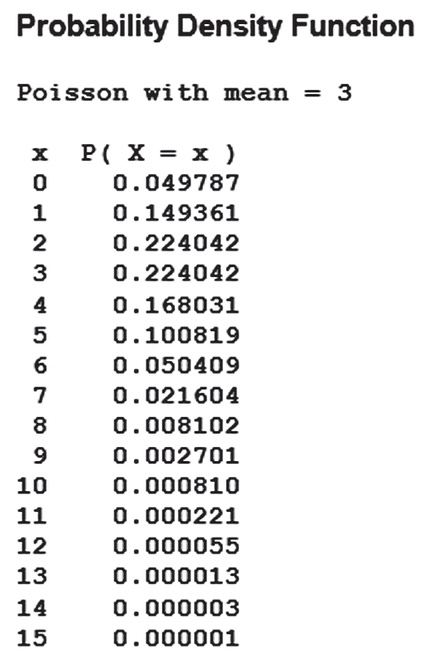
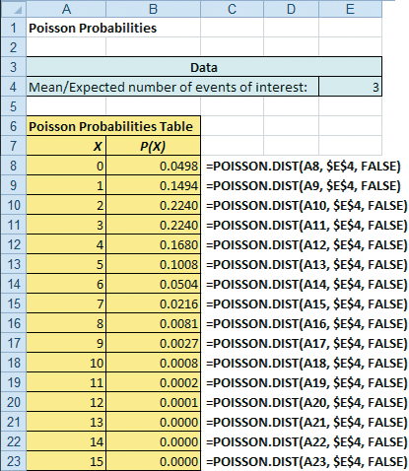
Excel & Minitab Can Be Used For The Poisson Distribution

Slide 32
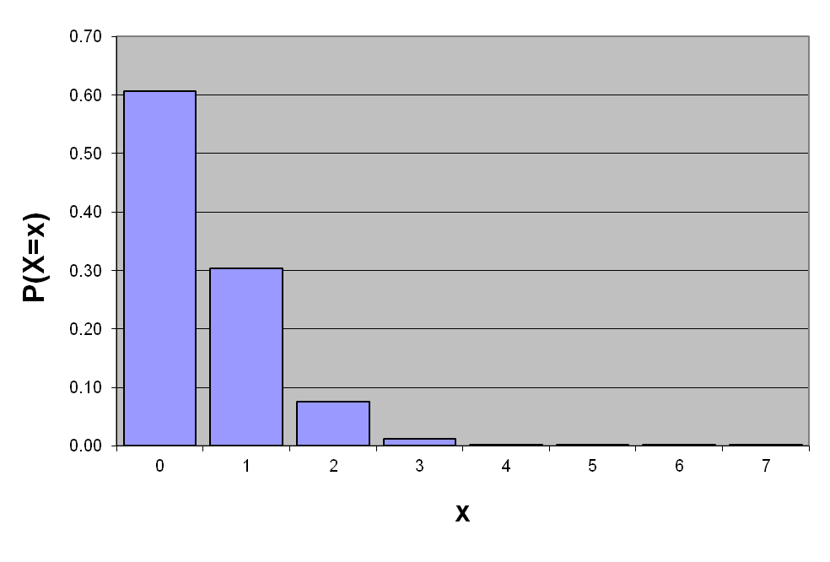
Graph of Poisson Probabilities
Graphically:
λ = 0.50
X | λ = 0.50
0 1 2 3 4 5 6 7 | 0.6065 0.3033 0.0758 0.0126 0.0016 0.0002 0.0000 0.0000
P(X = 2 | λ=0.50) = 0.0758

Slide 33
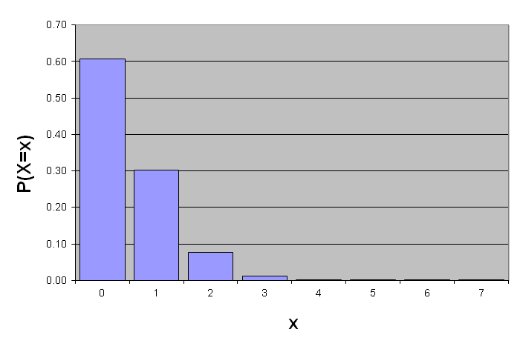
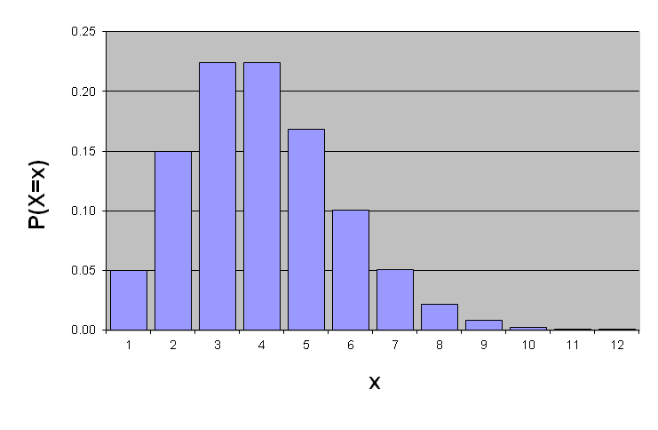
Poisson Distribution Shape
The shape of the Poisson Distribution depends on the parameter λ :
λ = 0.50
λ = 3.00

Slide 34
Chapter Summary
In this chapter we covered:
The properties of a probability distribution.
To compute the expected value and variance of a probability distribution.
To compute probabilities from binomial, and Poisson distributions.
To use the binomial, and Poisson distributions to solve business problems

